Slide 1
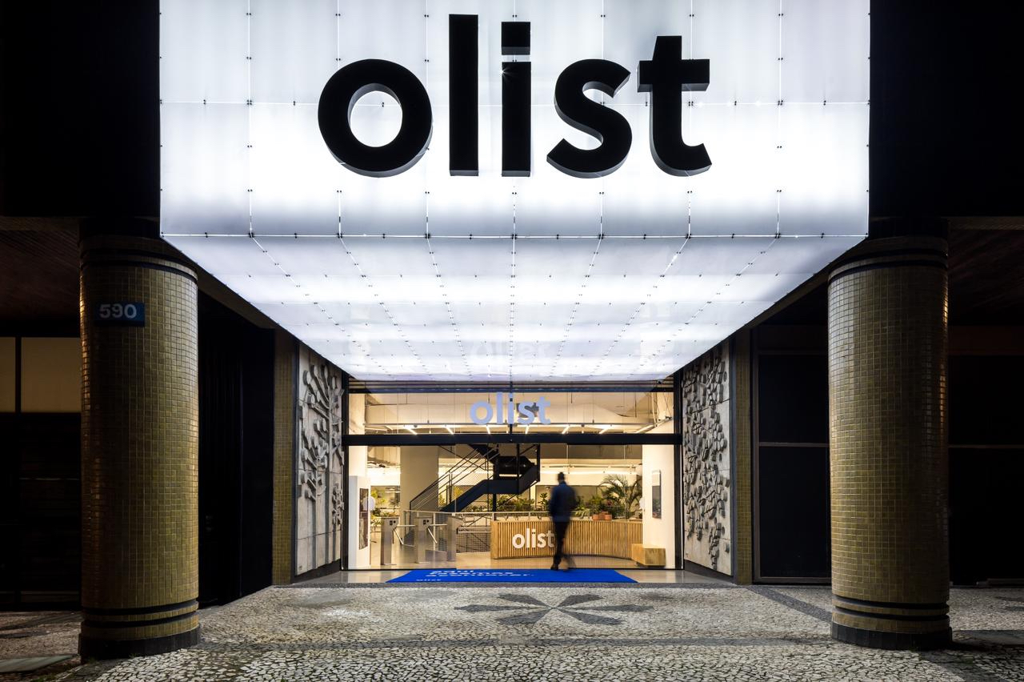
Rosana Infante
Notes:
This analysis is based on a public dataset published on Kaggle that was provided by Olist of 100k orders from 2016 to 2018.

Slide 2
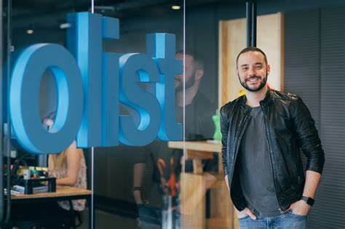
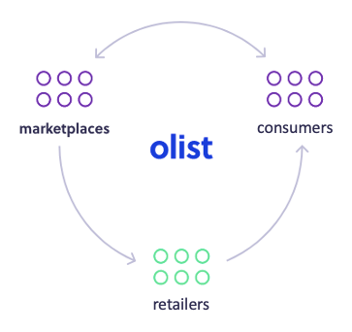
Brazilian Ecommerce Startup
Founded by Tiago Dalvi in 2015
Valued at $1.5 Billion
Connects small businesses to large product marketplaces such as Mercado Libre and Amazon connecting retailers to a broader customer base
Has more than 45,000 shopkeepers and retailers as clients
Expanded operations to Mexico in 2021 and looks to expand throughout Latin America

Slide 3
Interested in becoming an Olist seller?
What sells most & where?
What payment types are most beneficial?
What are the top sellers doing?

Slide 4
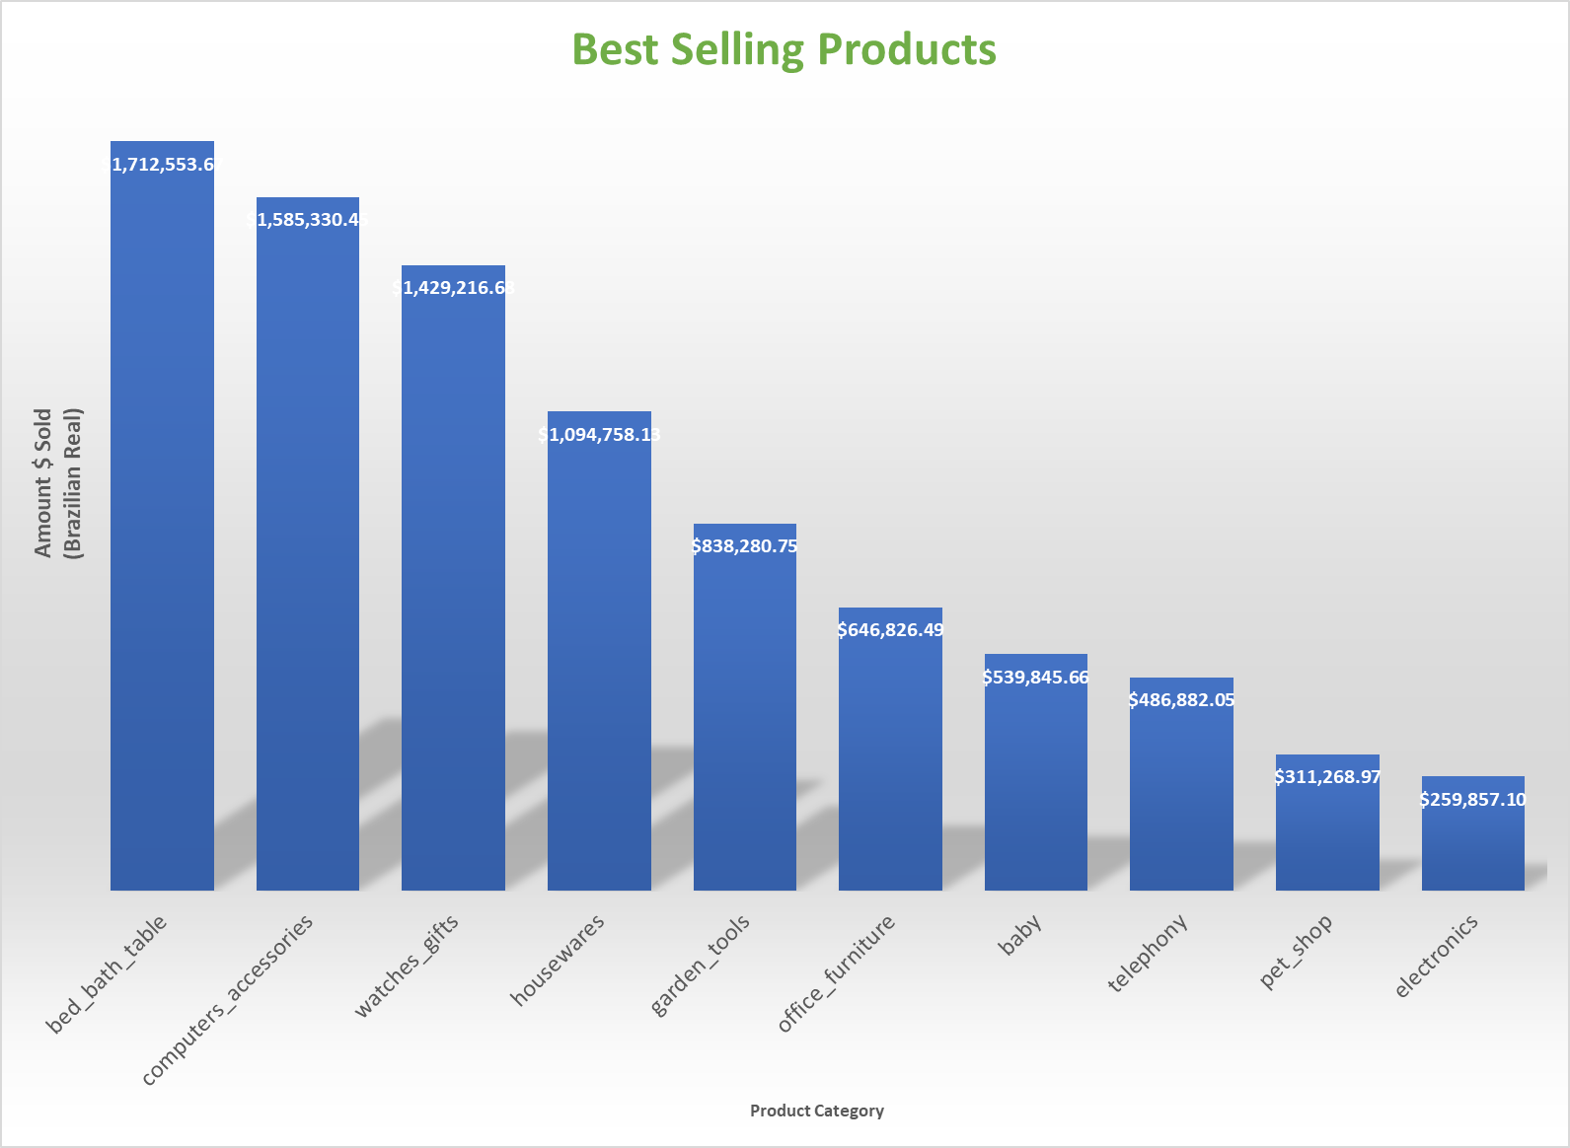

Slide 6
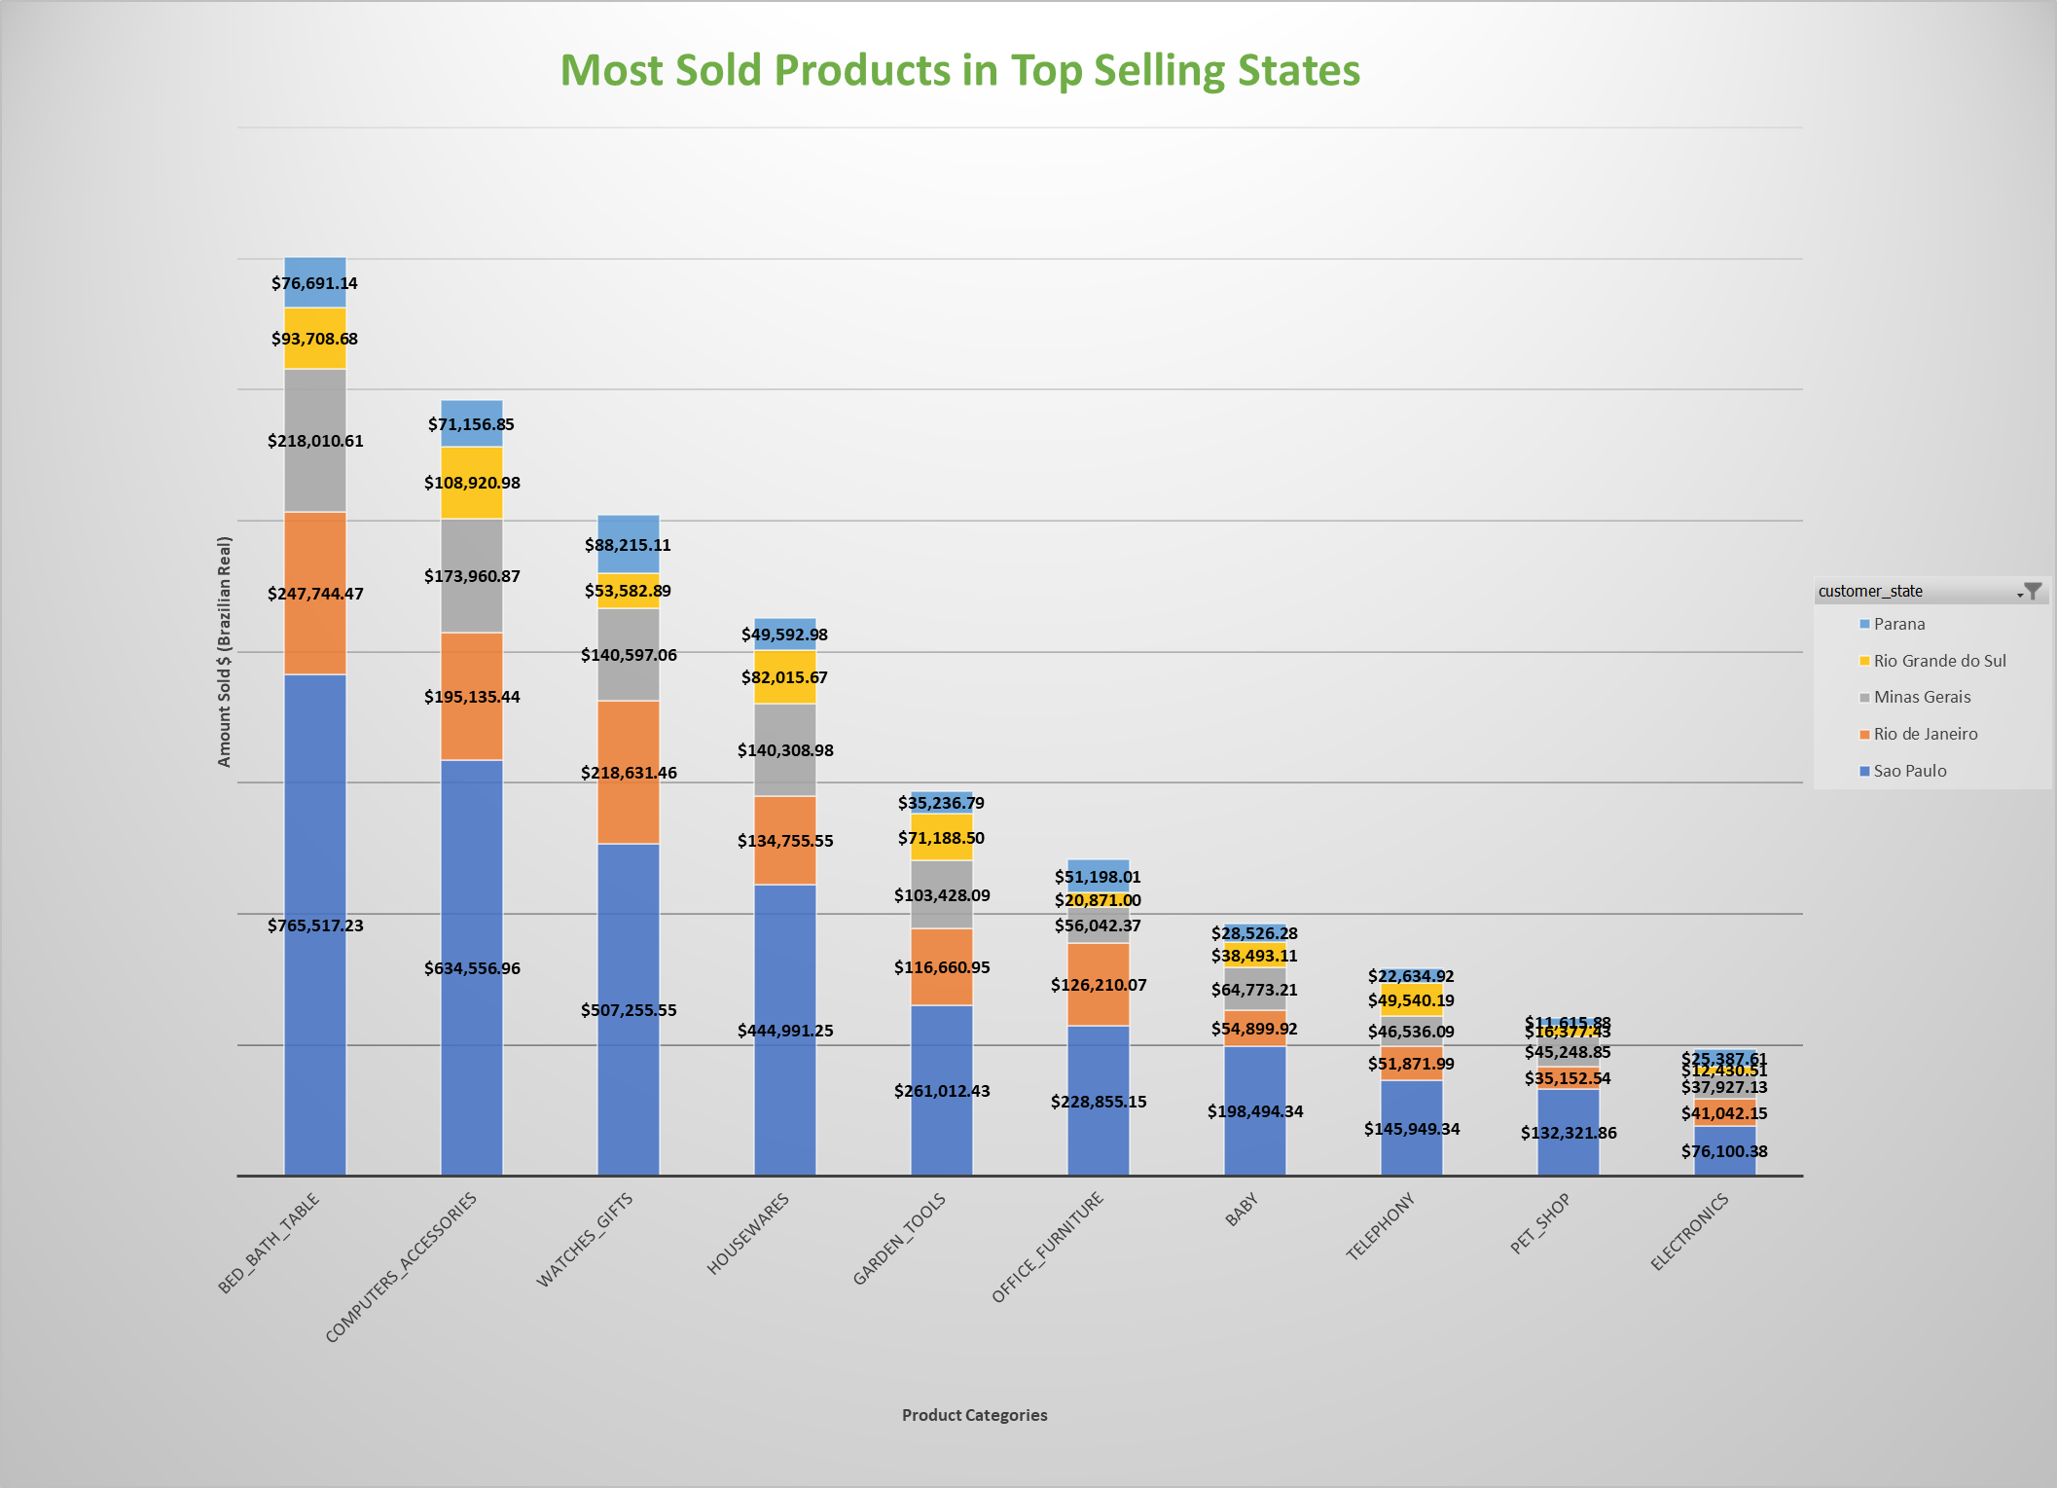

Slide 7
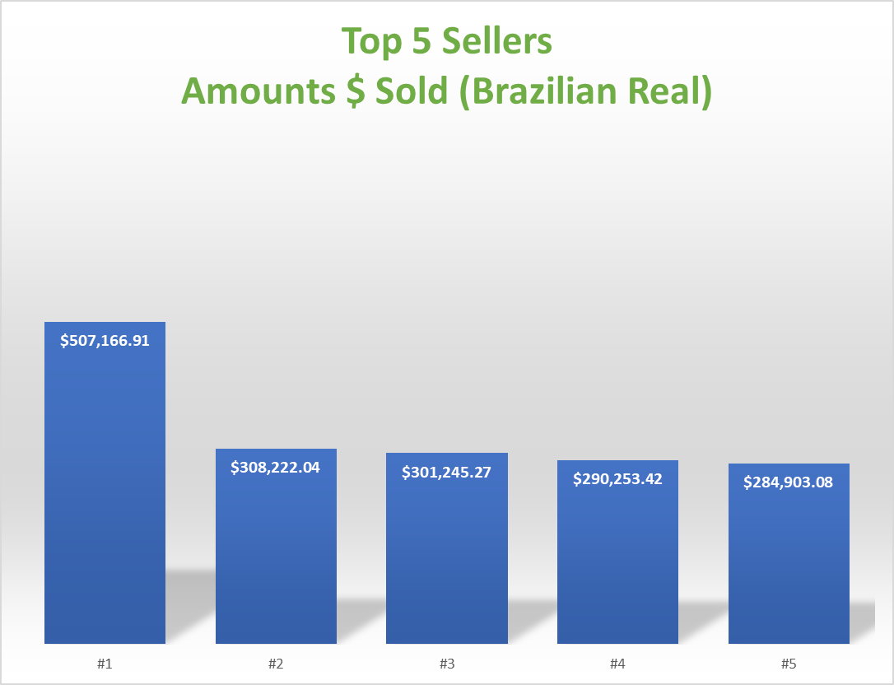

Slide 8
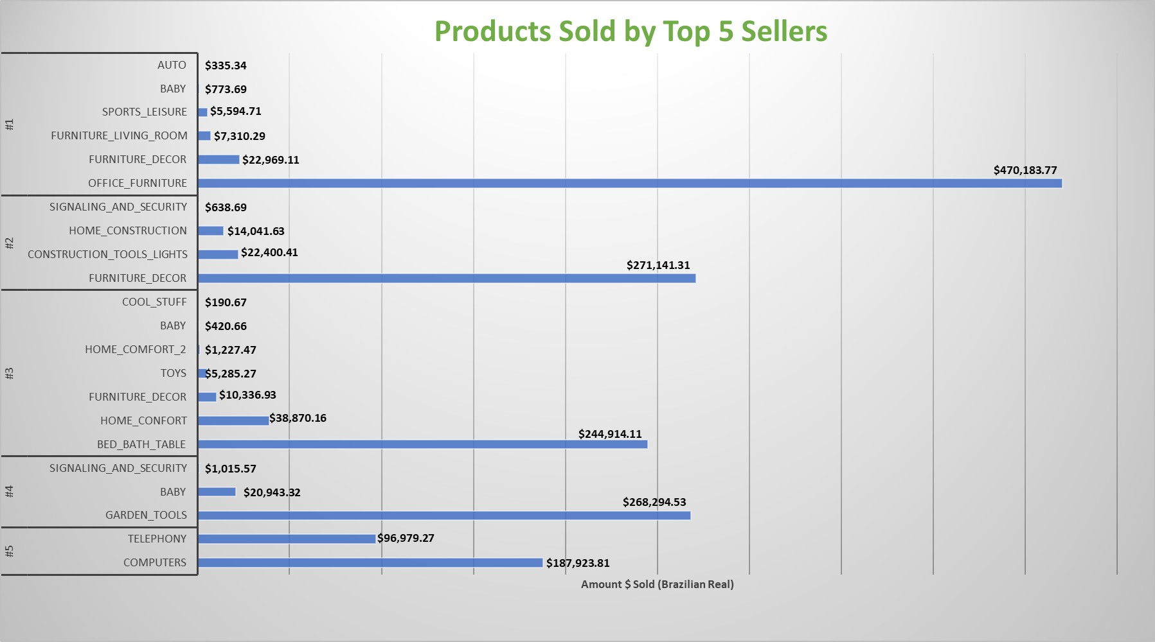

Slide 9
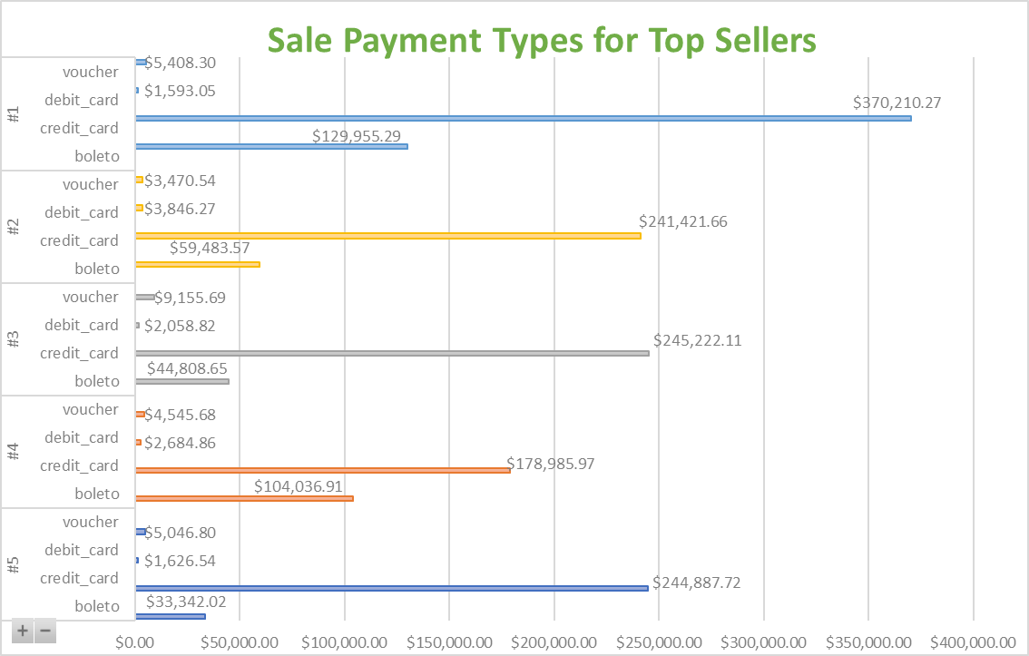

Slide 10
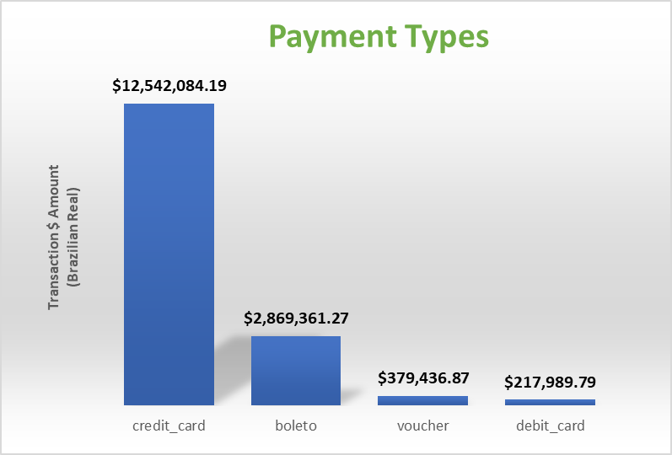

Slide 11
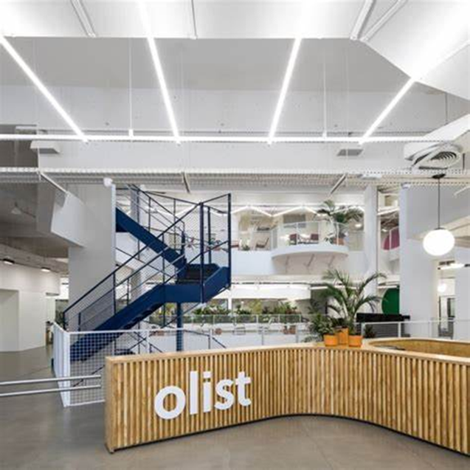
Recommendations
Choose a best-selling product category.
Advertising should be geared to customers’ top selling locations.
Prepare to accept credit card or boleto payments.

